Slide 1

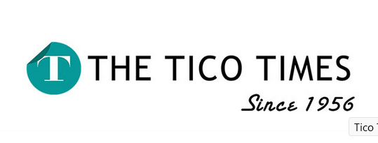
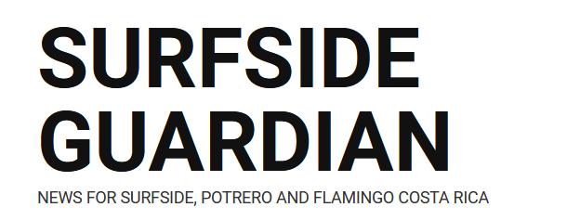

What do you think about this Costa Rican news?

Slide 2
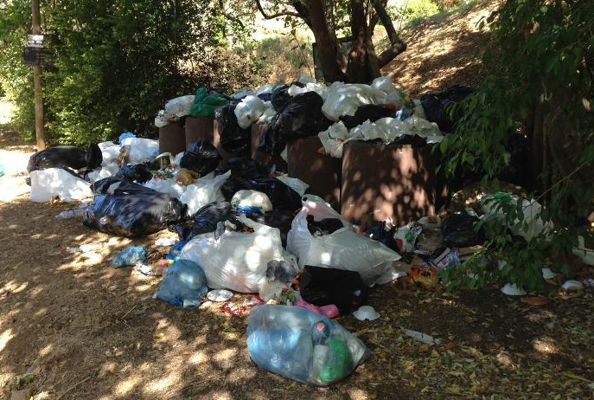
Trash and Littering Still Major Problems in Guanacaste, Costa Rica (2014)

Slide 3
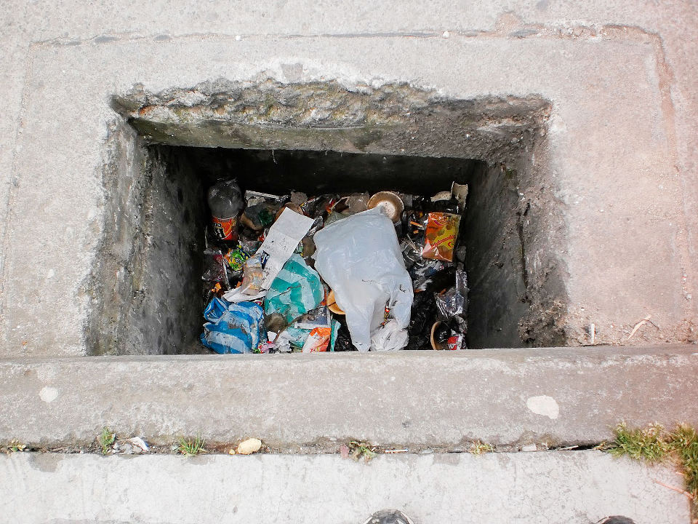
Costa Ricans Have To Change Their Littering Habits (2015)

Slide 4
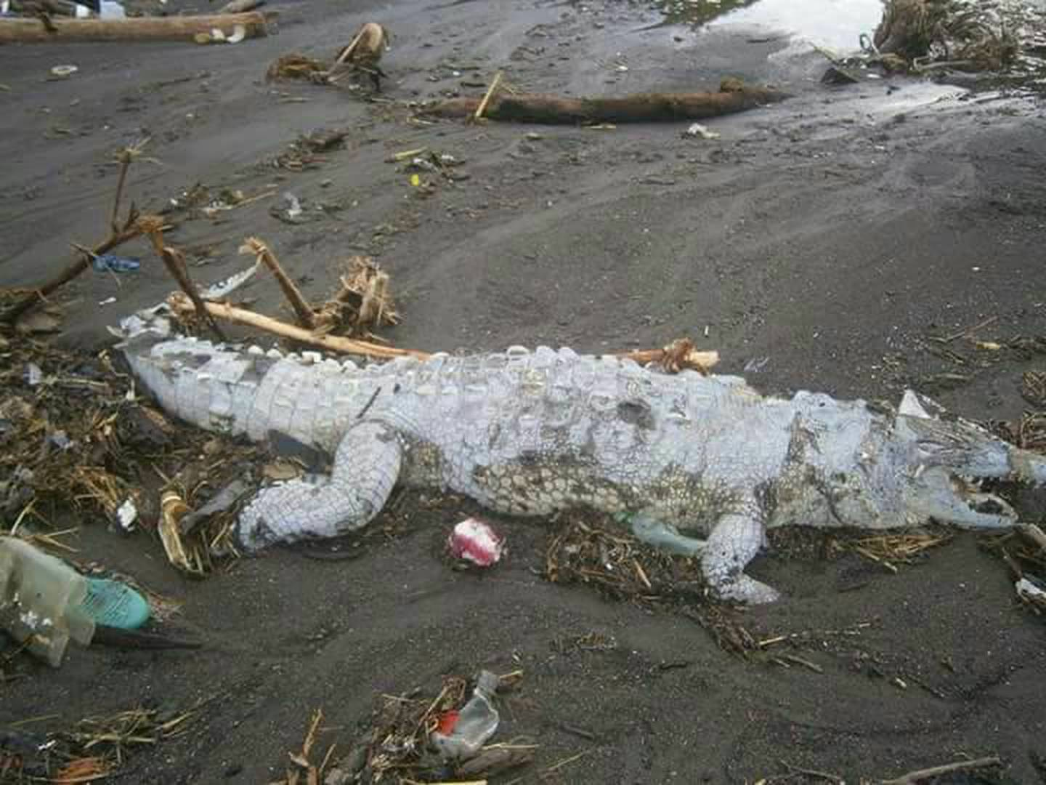
Dead crocodile was found in Bajamar beach. He ate garbage. (2017)

Slide 5
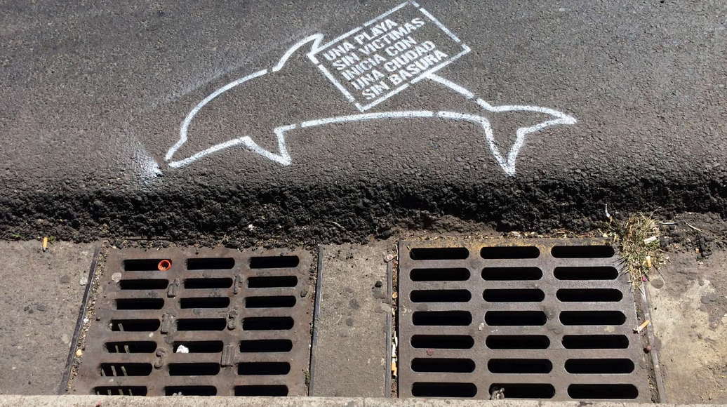
Messages along San José’s streets ask people to stop littering (2017)

Slide 6
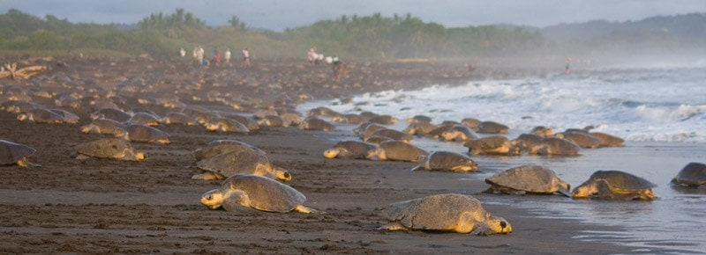
Costa Rican Marine Life. (2019)

Slide 7
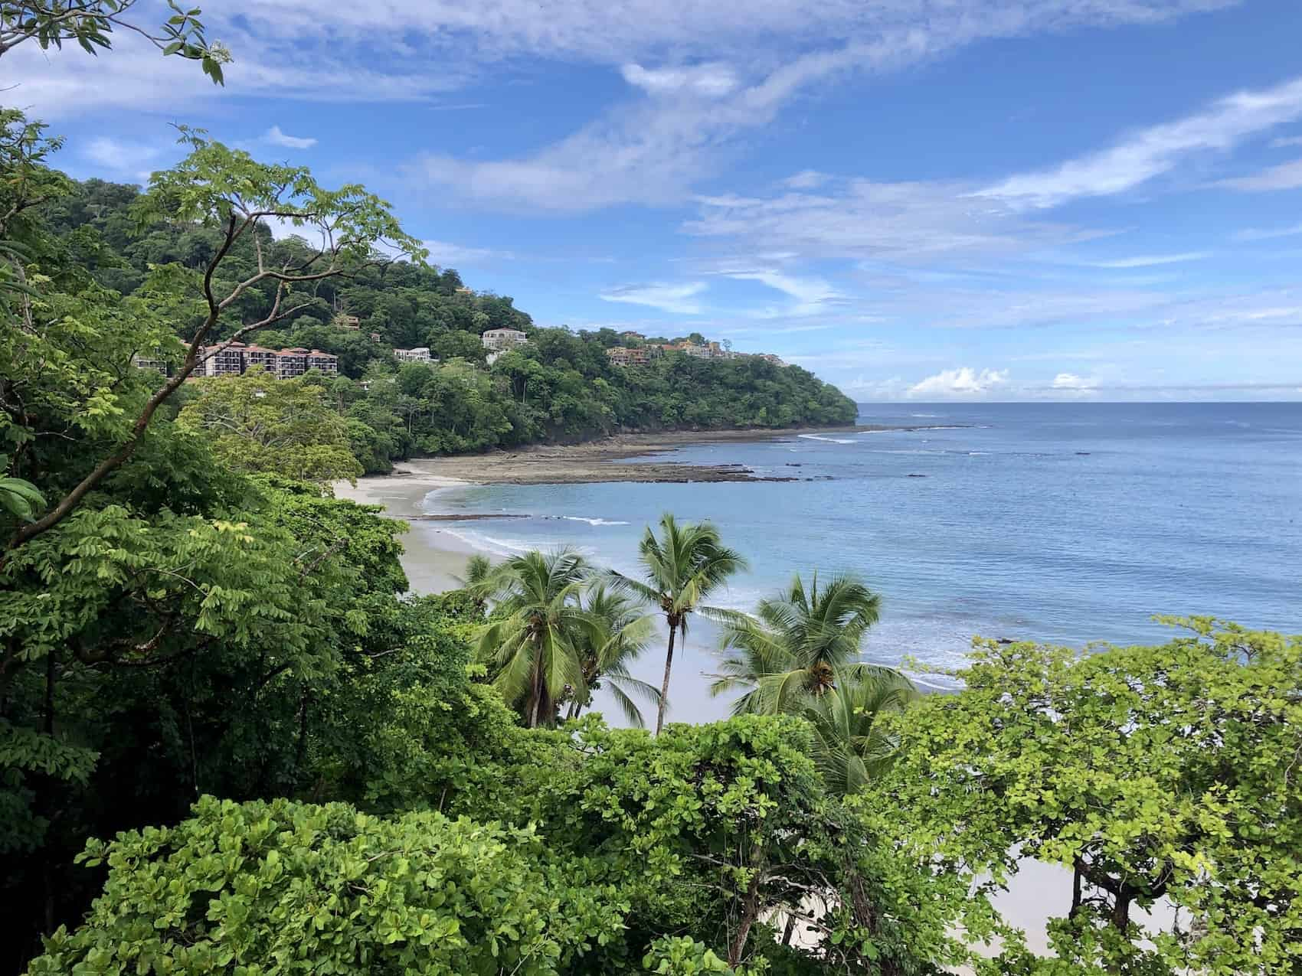
Costa Rica’s cleanest beaches get blue flags (2020)

Slide 8

Recycling in Costa Rica: Combating Renewable Waste Issues (2021)

Slide 9
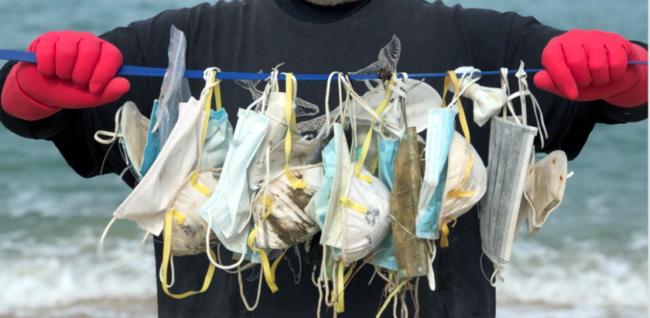
The Impact of COVID-19 on Marine Plastic Pollution (2021)

Slide 10


